Slide 1
Grammar & BAsics
Lecture 2 Tenses and related topics

Slide 2
Agenda
Recap Tenses
Tense related topics
Questions and negatives
Agreement

Slide 3
Tenses Session 2
The Future

Slide 4




Future tenses Compared What is the difference in meaning?
I will travel to New York some day.
I am going to travel to New York this summer.
I am travelling to New York tomorrow.
My plane leaves at 15:00.

Slide 5
Future tenses Compared What is the difference in meaning?
I will travel to New York some day.
I am going to travel to New York this summer.
I am travelling to New York tomorrow.
My plane leaves at 15:00.
Prediction, neutral attitude
Plan, intention
Arrangement
Fixed in a timetable

Slide 6
Will is used…
For predictions
[I think that] Kamala will win.
Tomorrow will [probably, however I don’t know] be rainy.
For decisions made at the moment of speaking
[phone ringing] I’ll get it / I will get it.
“John called.” –“Ok, I will call him back.”

Slide 7
‘Going to’ is used:
For plans and intentions
I’m going to buy a new car.
We are going to visit my sister on Monday.
When there are signs of something happening
Look at the clouds. It‘s going to rain.
That vase is tipping on the edge of that shelf. It’s going to fall down.

Slide 8
FutureTenses Compared What is the difference in meaning?
Oh, I‘ll buy some chocolate on my way there.
(I think/I hope) I‘ll have so much fun this weekend.
I think he’ll fail.
I‘m going to buy some chocolate on my way there.
I‘m going to have so much fun this weekend.
He didn’t study. He’s going to fail.

Slide 9
Present forms to talk about the future
In some cases you can use a present form to talk about the future
Instead of I’m going to do, you can also use I am doing when talking about plans and intentions
Especially if you have already made the arrangements
We are flying to Australia tomorrow.
I am seeing my dentist next Tuesday
Make sure to add a reference to the future (tomorrow, next …, etc.) to avoid confusion

Slide 10
Present forms to talk about the future
The present form without -ing (I work) is not used often to talk about the future
It is used when talking about things that are fixed in a schedule or timetable
The autumn break starts on October 20th.
Their plane arrives at 10:15

Slide 11
Grammatical Tenses: Recap
What have you remembered about tenses?
Imagine the following story and try and fill in the correct tenses, if it helps imagine yourself explaining this to someone…
You can do this on a handout
Next month I (move) …. to a new flat and I (already/buy) … the furniture. I can’t wait! Let me tell you more about the flat: there are two big rooms, a kitchenette and a small bathroom. Last weekend I (get) … a very nice lamp for the living room, but unfortunately I (break) … it when I (clean) … the flat. How clumsy of me! Luckily it (not/cost) … much, I (probably/buy) … another one next Saturday.
By the way, I have some news to tell you: While I (look) … for the flat, I (meet) … a very nice estate agent: his name is Jamie. We (go)… out for dinner twice and tomorrow we (have) … lunch together. He (work) … near here.
Now I (wait) … for my sister. We (go) …to a party together later and I (not/know) … what to wear: my old flat is full of boxes and I can’t find a nice dress.
Notes:
Am moving
Have already bought
Got
Broke
Was cleaning
Didn’t cost
Will probably buy
Was looking
Met
Went
Are having
Works
Am waiting
Are going
Do not know

Slide 12
Answers:
1. am moving, have already bought
2. got, broke, was cleaning
3. didn’t cost, will probably buy
4. was looking, met
5. went, are having, works
6. am waiting, are going, do not know

Slide 13
Questions and Negations

Slide 14
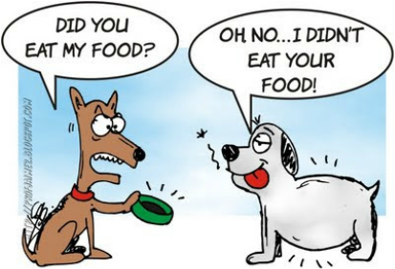
Questions and Negations
Tenses – describe actions
But language and speaking requires more than 1 person, so we also need to be able to INFORM ABOUT or DENY an action.
Sentence needs restructuring for questions!
Sentence needs adding for negations!

Slide 15
Attention: this exercise tests your knowledge of the info that follows
Change these statements into questions. Think about adding the verb “do” and about word order.)
1. You need to do this.
2. I know you.
3. You were not responsible
4. You will be able to leave later
5. Sally has not requested a meeting with me.
6. You would have loved to have a second chance.
7. Tim was hoping we would understand.
8. He can’t see it clearly.
9. Ingrid plays in the orchestra
10. The new rules are not here to stay

Slide 16
Answers
Change these statements into questions
1. Do you need to do this?
2. Do I know you?
3. Weren’t you responsible?
4. Will you be able to leave later?
5. Hasn’t Sally requested a meeting with me?
6. Would you have loved to have a second chance?
7. Was Tim hoping we would understand.
8. Can’t he see it clearly?
9. Does Ingrid play in the orchestra?
10. Aren’t the new rules here to stay?

Slide 17
There may not be classtime for the following slides, but if you found this exercise different, they will explain the concepts.

Slide 18
Asking yes/no questions
Is he American?
Are you from around here?
Has he been on television?
Is he playing football?
With forms of be (is, am, are, were): move it to the beginning of the sentence
When there is more than one verb: move the first one to the beginning of the sentence

Slide 19
“Do”-support Asking yes/no questions
If there is only one verb in the sentence
She plays football
Add ‘do’ to the beginning of the sentence
Does she play football?
As always add -es, for he, she, it
Does he play football?
Note that the -s is added to ‘do’, not to ‘play’
Does she plays football?

Slide 20
Asking yes/no questions about the past
If there is only one verb in the sentence
I played football
Add ‘did’ to the beginning of the sentence, and use the normal form of the verb (without -ed)
Did I play football?
This form is the same for you, we, he, she etc.
Note that only ‘did’ is the past form, not ‘play’
Did he played football?

Slide 21
Asking yes/no questions
Whenever there a helping or modal verb, don’t add “do”-support. Just change the word order.
You are going → Are you going?
She has seen → Has she seen?
He doesn’t care → Doesn’t he care?
He will go → Will he go?
She can speak → Can she speak?
It could work → Could it work?
You would like → Would you like?

Slide 22
“Do”-support Wh-questions
You can add Wh-words
who, what, why, where, which, when, how
at the beginning of a question to make another type of question
How does he travel to school every day?
Why are we going to school right now?
When did we go to school?
How long have you worked there?

Slide 23
Wh-questions
Sometimes who, what, or which is the subject of the sentence.
In that case you just use that word to replace the subject of a normal sentence (you don’t use do, does or did)
John called Emma → Who called Emma?
Amsterdam is the capital of the Netherlands → What is the capital of the Netherlands?
But if you want to ask about the object you have to use do, does or did
John called Emma → Who did John call?

Slide 24
Wh-questions
Some more examples
Who wants something to eat?
Who does want something to eat?
What happened to you last night?
What did happen to you last night?

Slide 25
“Do”-support Negative sentences
Negative sentences are very similar to questions
Whenever there are two verbs, add ‘not’ between the two verbs
You are going → You are not going
She has seen → She has not seen
He will go → He will not go
She can speak → She cannot speak
It could work → It could not work
You would like → You would not like
Notes:
Point out the contracted forms

Slide 26
Negative sentences
But if there is only one verb in the sentence, we need to use “do”-support (in combination with ‘not’)
I play football → I do not play football
He plays football → He does not play football
Again, the -s is only used for ‘does’, not for ‘play’
He does not plays football

Slide 27
Negative sentences in the past
For the past you use ‘did not’
I played football → I did not play football
He played football → He did not play football
Again, only ‘did’ is the past form , not ‘play’
I did not played football
He did not played football

Slide 28
Agreement

Slide 29
What is Agreement?
A sentence is made up of a Subject and a Verb
SUBJECT that tells us what/who the sentence is about.
It can be either a noun e.g.: dancer, book, cars, Sarah, etc. or a pronoun (I, he, she, we, they, etc.).
It can be either singular or plural.
VERB is the action in a sentence (am/is/are, walk(s), watch(ed),etc.).
Agreement happens when the Subject and the Verb are linked correctly e.g.: I walk – He walks

Slide 30
Noun forms and verb forms
When there is 1 of something it’s like he, she or it → verb + s
The boy gives (he gives)
The girl sleeps (she sleeps)
The machine works (it works)
When there is more than 1 of something it’s like they, we → normal verb form (without –s)
The boys give (they give)
The girls sleep (they sleep)
The machines work (they work)

Slide 31
Some verbs don’t change
Will, would, can, could, may, might, must, shall, should
The boy will give the boys will give
The girl can sleep the girls can sleep
The machines should work the machines should work

Slide 32
Words that can’t be counted
Take the same form as he, she or it
Water flows through the pipes.
Money makes the world go round.
Politics bores me to death.
Mathematics gives me headaches.

Slide 33
Some words always indicate more than one
These words take the same form as they
The cattle are transported to the slaughterhouse.
The police have the right to search people.
The personnel demand higher pay.
Also note
Een aantal mensen is er al.
A number of people is already there
A number of people are already there.

Slide 34
Words that refer to a group
In the UK they get the same form as they,
in the US the same form as he, she or it
UK: Our family are unable to plan a holiday.
US: Our family is unable to plan a holiday.
UK: The government are planning a tax reform.
US: The government is planning a tax reform.
UK: The national football team have won.
US: The national football team has won.

Slide 35
Things with two equal parts
Things that consist of two equal parts are treated as if there’s more than one
Trousers, glasses, pants, pyjamas etc.
They get the same form as they
Those trousers make you look fat.
My glasses help me read.
If you want to count these words, you use 2 pairs of… (the form of the verb is still like with they).
2 pairs of pyjamas cost only 20 euros today.

Slide 36
Note
Some words look like they refer to more than one, but it is only one
They take the form of he, she or it
The Netherlands has two neighbouring countries.
The United States has strict laws.
If you measure something, use the form of he, she or it, even if it’s more than one
Ten miles is too far
Two kilos seems to be too much.

Slide 37
Future tense exercise
See handout

Slide 38
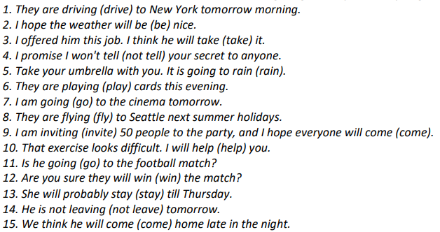
Future tense exercise Answer key:

Slide 39
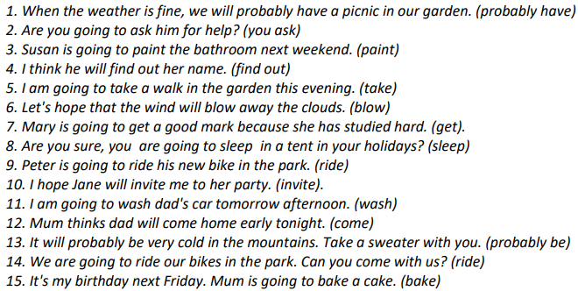
Future tense exercise Answer key (cont.)

